Slide 1
Startup Case Study
I have been approached by Umoja Enterprises Investment. The board of directors are currently reviewing 1000 potential interesting startups and deciding on which ones to invest in.
The criteria for selecting investments for this fund is a combination of:
High Revenue (2015).
Low Expenses (2015).
Top Growth (2015).
The task was to assist the board in identifying which businesses represent the best investment opportunities.

Slide 2
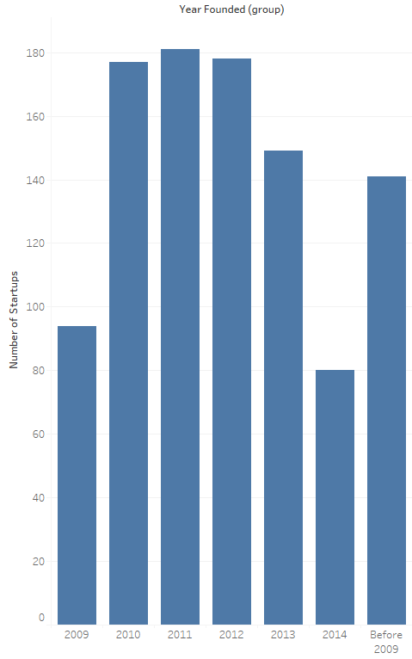
Year Founded(Group)

Slide 3
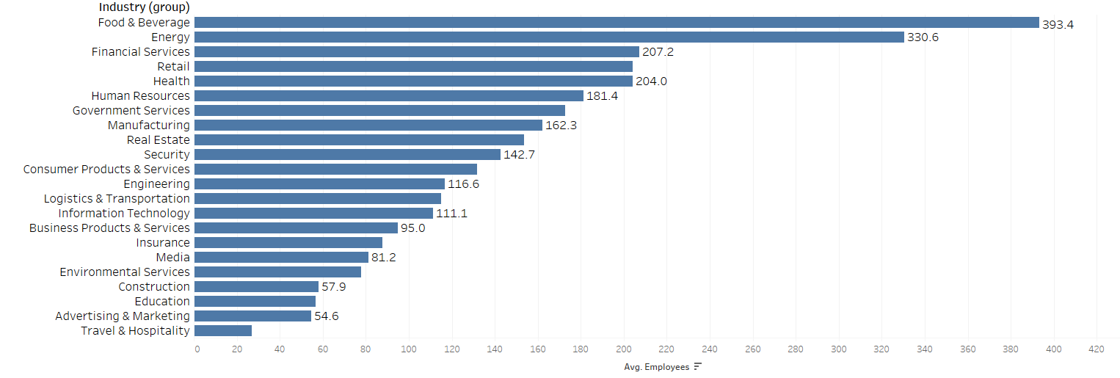
Industry Groups

Slide 4
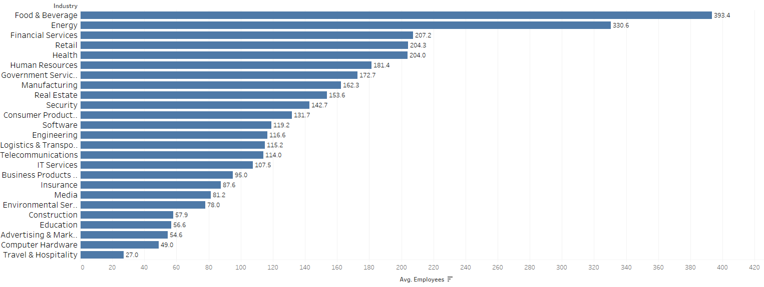
Industry Sets

Slide 5
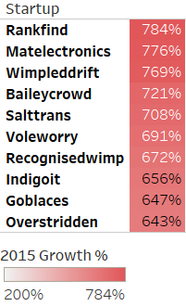
Top 10 Performers

Slide 6
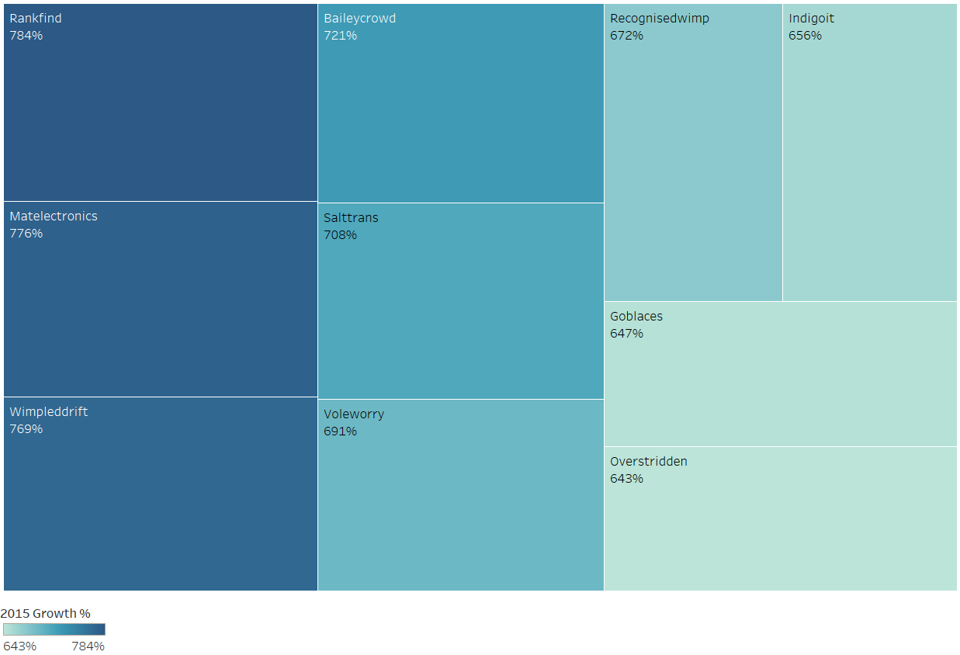
Tree map Analysis

Slide 7
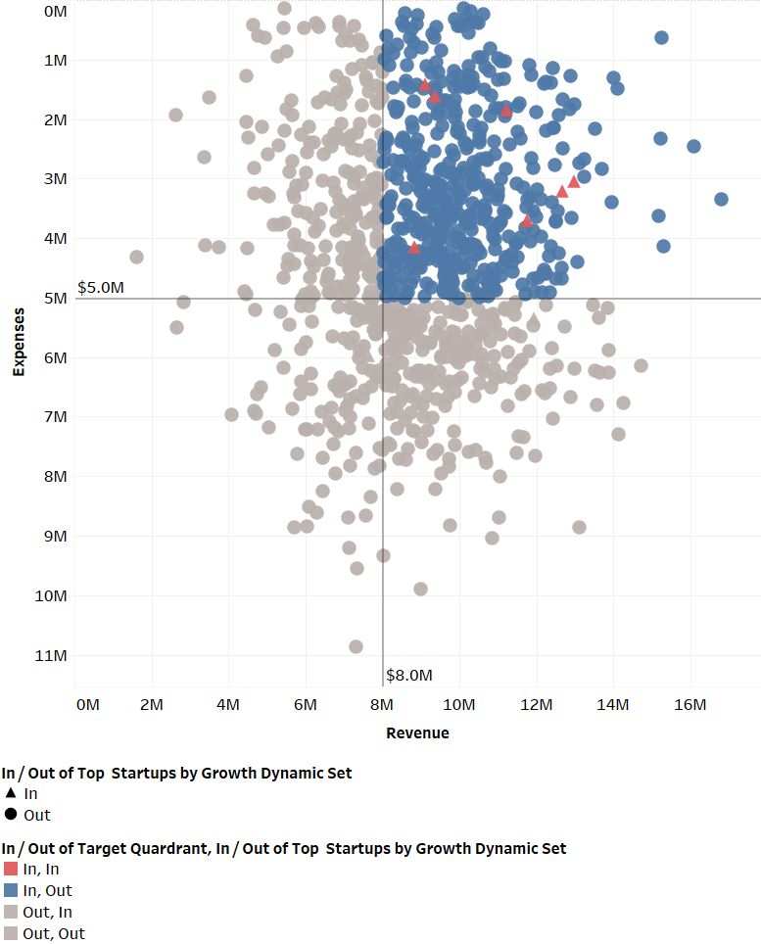
Revenue/Expenses Analysis

Slide 8
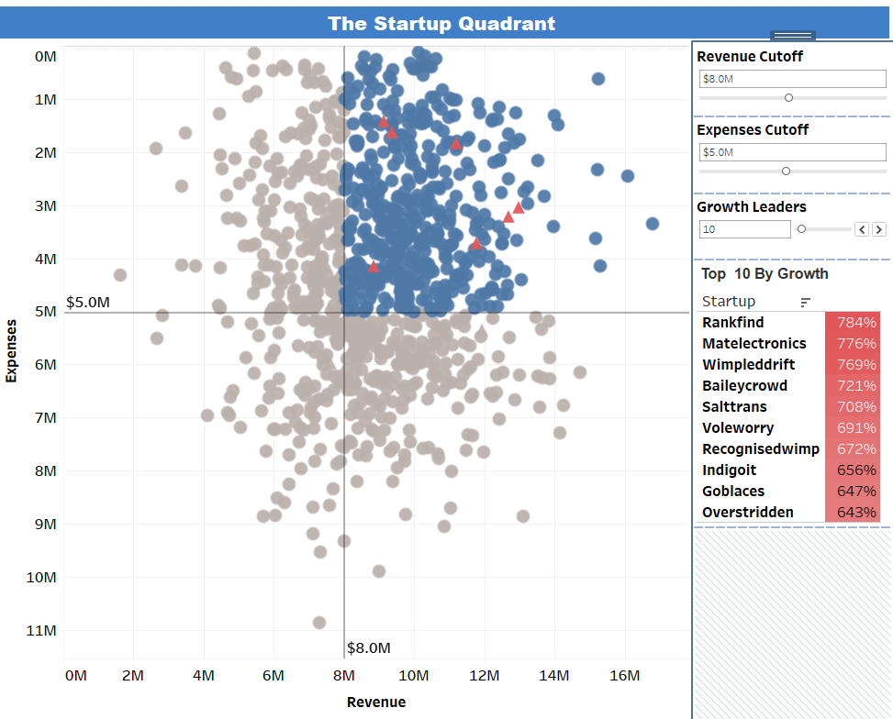
The Startup Quadrant Dashboard

